Slide 1
Physics 201
Winter 2013
Uniform circular motion

Slide 2
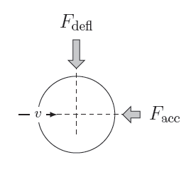
If the puck is moving, a further decomposition is important
Winter 2013
Remember me?
This will deflect the path of the puck
Force in line with the motion – will change speed
Force perpendicular to the motion – will change direction
This will slow the puck down

Slide 3
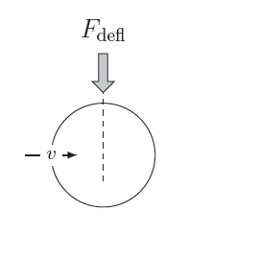
Now we focus on forces that bend motion
Winter 2013
This will deflect the path of the puck
Force perpendicular to the motion – will change direction

Slide 4
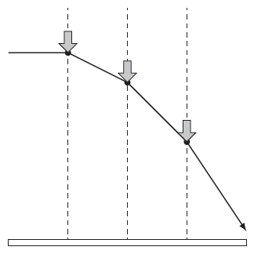
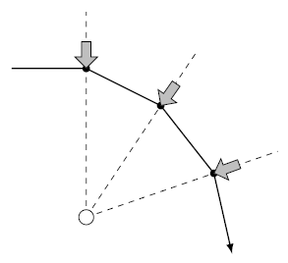
We have seen an example in projectile motion
Winter 2013
Constant Force
Central Force

Slide 5
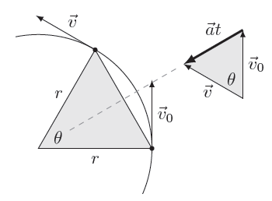

Uniform circular motion needs a specific magnitude of force
Winter 2013

Slide 6
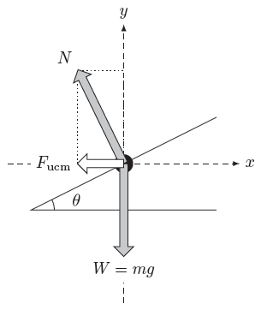

It is the net force which supplies centripetal motion
Winter 2013
Show me

Slide 7
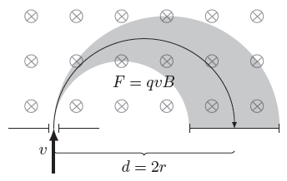

Mass spectrometer
Winter 2013
Show me

Slide 8
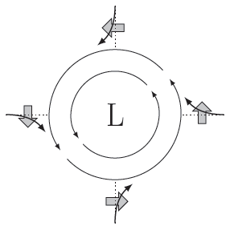
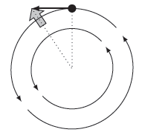
Rotating frames introduce two inertial forces
Winter 2013
Centrifugal Force
Coriolis Force
“Stationary” objects will be pushed away from the rotation
Movement toward the rotation will push you into the rotation

